Slide 1
Meanings and types of Macroeconomics
BCA Sixth Semester

Slide 2
Meanings of Macroeconomics
It is believed that the term ‘Macro’ is derived from the Greek word ‘MAKROS’ which means large or average. Therefore, Macroeconomics examines the behavior of the whole economy. The term Macroeconomics was first used by Ragner Frisch in1933. Macroeconomics is the branch of economics which deals with the economy as a whole. It studies the aggregate variables like NI, money, Price level, unemployment, economic growth, etc.
Macroeconomics is a relatively new branch of economics. The theory of Macroeconomics was developed by J. M. Keynes in 1936 by his book named ‘The General Theory of Employment, Interest and Money’ popularly known as ‘The General Theory’. Therefore, J. M. Keynes is known as ‘Father of Macroeconomics’ and the theory of Macroeconomics is known as Keynesian economics. It is a relatively new branch of economics developed after the publication of Keynesian General Theory in 1933, So it is also called new economics.

Slide 3
Definition of Macroeconomics
Macroeconomics deals not with individual quantities but with aggregate of these quantities not with individual income; but with national income, not with individual prices but with price levels; not with individual outputs but with national output.
K. E. Boulding
Macroeconomics deals with the functioning of the economy as a whole, including how the economy’s total output of goods and services and its total employment of resources are determined and what causes these totals to fluctuate.
Edward Shapiro
Theory of Income and Employment
Aggregative Economics

Slide 4
Main Features of Macroeconomics
The main features of Macroeconomics are:
It is aggregate economics.
It is related to the behavior of the economy as a whole.
It is a policy science and more normative.
It is an income and employment theory.
Fiscal and monetary policy is its main analytical tools.
It is relatively new economics developed after 1936.
NI, total consumption, expenditure, saving, investment are its principal variables.
Achievement of full employment, price stability, economic growth, NI accounting are the main objectives of Macroeconomics.

Slide 5
Scope of Macroeconomics
Macroeconomic theory
Macroeconomic theory
Theory of Income and Employment
Theory of General Price Level
Theory of Economic Growth
Macro Theory of Distribution
Theory of Consumption
Theory of Investment
Theory of Business Cycle

Slide 6
Types of Macroeconomics:- According to the nature of equilibrium on the basis of time, macroeconomics can be classified into three types. They are:- 1. Macro-static:- The static analysis explains the final position of equilibrium of the whole economy at a particular point of time. It shows the still picture of the economy as a whole. It investigates the relation between macro variables in the final position of equilibrium.
Y
In the given figure, the aggregative demand curve (C+I) and aggregate supply curve (45° line) are intersected at point E. The point E is the equilibrium point where the equilibrium level of NI is OY. As aggregate demand and aggregate supply refers to the same point of time it is a static analysis.
Aggregate Supply
Y=C+I
C+I
C
C+I
Aggregate Demand
E
O
X
Y
National Income

Slide 7
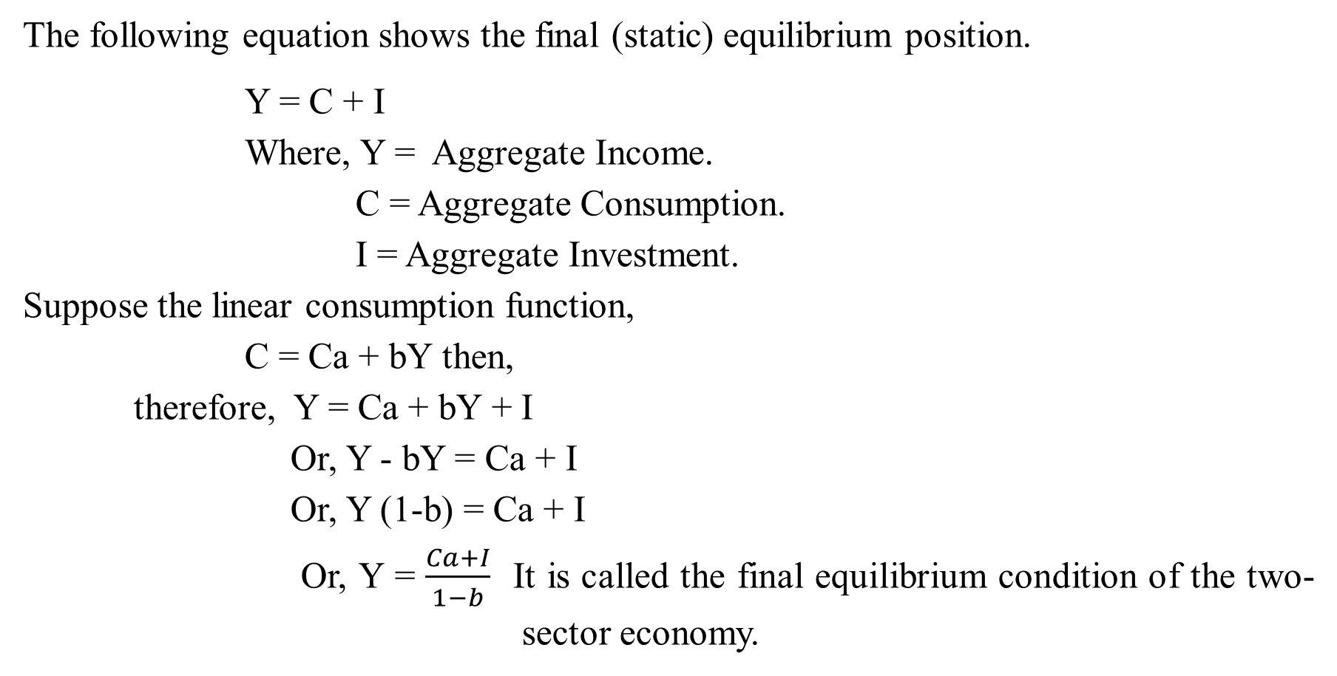
Contd…..
The following equation shows the final (static) equilibrium position.
Y = C + I
Where, Y = Aggregate Income.
C = Aggregate Consumption.
I = Aggregate Investment.
Suppose the linear consumption function,
C = Ca + bY then,
therefore, Y = Ca + bY + I
Or, Y - bY = Ca + I
Or, Y (1-b) = Ca + I
Or, Y = $\frac{Ca+I}{1−b}$ It is called the final equilibrium condition of the two- sector economy.

Slide 8
2. Comparative Macro-static:- Comparative macro static refers to a comparative study of different equilibrium situations at different points of time. It compares old equilibrium with new equilibrium but it does not study about the disequilibrium that occurs in passing from one equilibrium to another. Comparative macro static explains how the second equilibrium is different from the first equilibrium.
Comparative Macro-Static
Initially, AD curve intersects with AS curve at point E, and determines OY equilibrium level of income. Let us suppose, aggregate demand curve shifts from C+I to C+I+ΔI then the equilibrium point also shifts from E to E_{1.} The new equilibrium points gives OY₁ equilibrium level of national income. The comparative macro static compares the equilibrium points E to E₁ but does not explain how the new equilibrium is achieved.
Y
Aggregate Supply
Y=C+I
E₁
C+I+ΔI
C+I
C
C+I
E
Aggregate Demand
O
X
Y
Y1
National Income

Slide 9

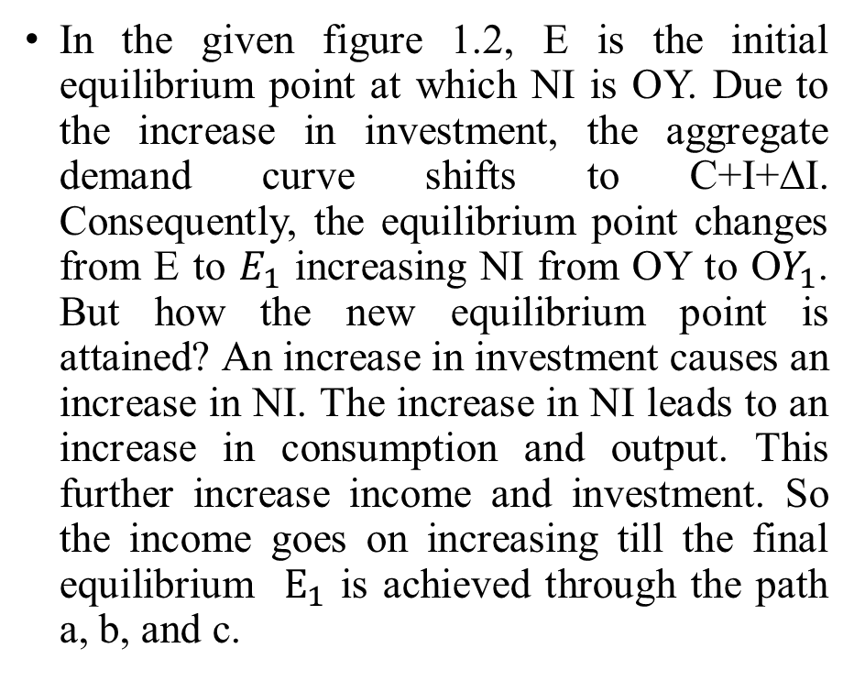
3. Macro Dynamic:- The concept of dynamic analysis was introduced by Ragnar Frisch, Robertson, and J. R. Hicks. Dynamic analysis is the study of the process by which the economy moves from one equilibrium point to another as a result of a change in macroeconomic variables. The dynamic macroeconomic analysis explains the path of change in the equilibrium aggregate income.
In the given figure 1.2, E is the initial equilibrium point at which NI is OY. Due to the increase in investment, the aggregate demand curve shifts to C+I+∆I. Consequently, the equilibrium point changes from E to $E_{1}$ increasing NI from OY to O$Y_{1}$. But how the new equilibrium point is attained? An increase in investment causes an increase in NI. The increase in NI leads to an increase in consumption and output. This further increase income and investment. So the income goes on increasing till the final equilibrium $E_{1}$ is achieved through the path a, b, and c.
Figure of Macro Dynamic
Y, C, I
Y-
C+I +∆I
E₁
C+I
c
a a
E
National Income
X
O
Y
$$Y_{1}$$

